Slide 1
Introduction to GenAI and Simple LLM Inference on CPU and Fine-Tuning of LLM Model to Create a Custom Chatbot
Vaibhavv Maheshwari, IT, MIT Manipal
Daksh Loiya, IT, MIT Manipal

Slide 2
Unique Idea Brief (Solution)
.
In the digital age, the overwhelming volume of textual data poses a challenge for efficient information extraction. Manual summarization processes are time-consuming and prone to inconsistency, hindering quick decision-making and information dissemination. There is a critical need for an automated solution that can accurately distill key insights from large textual datasets across various domains.
Solution Overview-Introducing an advanced text summarization model leveraging Google FLAN Model, tailored for efficiency, accuracy, and scalability:
Domain Adaptability: Can be fine-tuned on domain-specific datasets to optimize summarization performance for specific industries or content types.
Evaluation and Validation: Facilitates objective evaluation of generated summaries using metrics like ROUGE scores, ensuring the quality and relevance of extracted information.
Real-time Summarization: Capable of generating summaries in real-time, supporting applications that require immediate access to distilled information.

Slide 3
Features Offered
Foundation on Google T5 Base Model:
Built upon the powerful Google T5 base model known for its robust capabilities in natural language processing tasks.
Customized for Summarization Tasks:
Fine-tuned the model using AutoModelForSeq2SeqLM specifically for sequence-to-sequence learning tailored to text summarization.
Efficient Data Utilization:
Trained on the CNN/DailyMail dataset, encompassing diverse news articles paired with human-written summaries, ensuring comprehensive learning and adaptation.
Optimized Training with LoRA:
Implemented Low-Rank Adaptation (LoRA) to streamline training, reducing computational complexity and enhancing training efficiency without compromising on summarization quality.
Mapping Function for Summarization:
Developed a sophisticated mapping function that transforms input queries into concise and coherent summaries, integrating seamlessly with the fine-tuned model.
ROUGE Score Evaluation:
Utilized ROUGE scores to objectively evaluate the quality of generated summaries, ensuring alignment with reference summaries and maintaining high standards of summarization accuracy.

Slide 4
Process Flow
Input Queries: Text inputs or queries to be summarized.
AutoTokenizer: Tokenizes the input queries to prepare them for processing.
Google Flan T5 Base Model: Acts as the foundational model for the text summarization system.
AutoModelForSeq2SeqLM: Fine-tunes the Google Flan T5 base model for sequence-to-sequence learning
specific to summarization tasks.
CNN/DailyMail Dataset: Provides the training data, consisting of news articles and corresponding summaries used to train the model.
LoRA (Low-Rank Adaptation): Optimizes the training process by reducing computational complexity and training time.
Mapping Function: Converts tokenized queries into concise summaries using the fine-tuned model.
Generated Summaries: Summaries generated by the mapping function.
ROUGE Evaluation: Measures the quality of generated summaries using ROUGE scores (ROUGE-1, ROUGE-2, ROUGE-L).

Slide 5
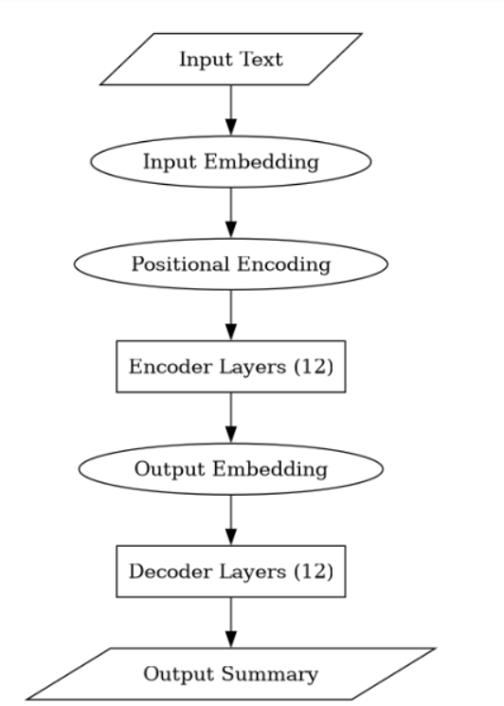
Architecture Diagram

Slide 6
Technologies Used
Google Flan T5 Base Model:
Utilized as the foundational model for natural language processing tasks, including text summarization.
AutoModelForSeq2SeqLM:
Applied to fine-tune the Google Flan T5 base model specifically for sequence-to-sequence learning tasks related to text
summarization.
AutoTokenizer:
Used for tokenizing input queries, ensuring standardized tokenization for processing by the sequence-to-sequence model.
CNN/DailyMail Dataset:
Selected as the training dataset, comprising news articles paired with human-written summaries, providing diverse
textual content for model training.
Low-Rank Adaptation (LoRA):
Implemented to optimize the training process by reducing computational complexity and training time, facilitating faster model
convergence.
Mapping Function:
Developed to convert tokenized queries into concise summaries using the fine-tuned model, enhancing summarization
accuracy and coherence.
ROUGE Score Evaluation:
Utilized ROUGE (Recall-Oriented Understudy for Gisting Evaluation) scores to evaluate the quality of generated summaries
by measuring overlap with reference summaries

Slide 7
Team Contribution
Daksh Loiya- Fine-tuned and Trained the model, helped with choosing the model
Vaibhavv Maheshwari- Helped with choosing the model and dataset also made the PPT and the report.

Slide 8
Conclusion
In this project, We successfully implemented a text summarization system using the Google Flan-T5 base model. By training it on the CNN/Daily Mail dataset and optimizing the process with Low-Rank Adaptation (LoRA), I developed a model capable of generating accurate summaries efficiently. The use of ROUGE scores to evaluate the quality of the summaries provided a clear measure of the model's performance, validating its ability to distill key information from input texts.
This project has been instrumental in deepening my understanding of advanced NLP techniques, including model fine-tuning, dataset preparation, and optimization strategies. It highlighted the importance of selecting appropriate evaluation metrics like ROUGE for assessing summarization quality objectively. Moving forward, these learnings will guide me in applying NLP models effectively to solve real-world problems and further exploring innovations in natural language processing.

